Slide 1
Greater Toronto Hockey League
Player Registration Manual
2021 – 2022
As of August 30, 2021

Slide 2
Contents
Section 1 – Player Registration Fee
Section 2 – Policies
Section 3 – Payment Process
Section 4 – Frequently Asked Questions (FAQs)

Slide 3
Section 1
Player Registration Fee

Slide 4
Player Registration Fee
The PRF fee can be paid in a single payment or in 4 installments.
The collection method is through the Hockey Canada online payments portal as either a one-time payment or Four separate equal installments – Upon registration, October 1, November 1, and December 1.
Payment methods accepted are Visa, MasterCard, and cheque.
The League will accept post-dated cheques provided they are delivered to the League Office prior to the due date and dated for the above noted deadlines.

Slide 5
Player Registration Fee
Fee Structure
1 player, no Parent Team Official: $735 or 4 installments of $193.75 ($775)
1 Player, 1 Parent Team Official: $585 or 4 installments of $156.25 ($625)
2 siblings, no Parent Team Official: $735+ $585 = $1320 or 4 installments of $350 ($1,400)
2 siblings, 1 Parent Team Official: $585 + $585 = $1170 or 4 installments of $312.50 ($1,250)
2 siblings (TWINS), 1 Parent Team Official: $585 + $585 = $1170 or 4 installments of $312.50 ($1,250)
2 siblings, 2 Parents are Team Officials (2 parents and 2 siblings on the same team or 1 parent + sibling on one team and other parent + sibling on the other team): $585 + 585 = $1170 or 4 installments of $312.50 ($1,250)
3 siblings, no Parent Team Official: $735 + $585 + $585 = $1,905 or 4 installments of $506.25 ($2025)
3 siblings, 1 Parent Team Official: $585 + $585 + $585 = $1,755 or 4 installments of $468.75 ($1,875)
3 siblings (TWINS + 1), 1 Parent Team Official: $585 + $585 + $585 = $1,755 or 4 installments of $468.75 ($1,875)
3 siblings, 2 Parent Team Official’s (same as 2 siblings/2 Team Official parents with third sibling playing in the GTHL as well): $585 + $585 + $585 = $1,755 or 4 installments of $468.75 ($1,875)

Slide 6
Section 2
Policies

Slide 7
Policies
All players require a completed PRF Registration with payment submitted/payment plan selected as a condition of approval.
A Player who has not paid the PRF, 15 days after outstanding payment notification has been issued, will become ineligible to participate and is subject to paying the full PRF.
A Player who suffers a season-starting or season-ending injury/ illness/ condition/ mental-health barrier, would be refunded on a pro-rated basis after the submission of a medical report indicating such.
A Player who suffers a short-term injury (they would be returning to play at some point during the season) is not eligible for a refund.
A Player who is suspended is not eligible for any refund.
A Player who is released from a team and does not re-sign with a GTHL Club prior to January 15 will be eligible for a pro-rated refund.

Slide 8
Policies
A Player who registers after the start of the regular season will be eligible for a pro-rated fee.
A player in a division that may have less than 28 games for A/AA/AAA will have their fee pro-rated.
A player in a division that may have less than 26 games in U17 or U18 A/AA will have their fee pro-rated.
A player in a division that may have less than 24 games in U21 A will have their fee pro-rated.
A Player who is entitled to a discount and paid the full amount for the PRF will be refunded accordingly.
A Player who is entitled to a discount and has paid in installments will have their last installment(s) adjusted accordingly.
A Team Official discount is only to be applied to a player whose parent is a Team Official on their roster and is registered and not released prior to/including December 15.
A Parent Team Official released prior to or on December 15 voids that player’s eligibility for the discount and the player is subject to owing the full fee.

Slide 9
Policies
A Sibling discount can only be applied if a player’s sibling(s) register prior to and including November 15.
A Sibling released prior to/on November 15 voids a player’s eligibility for the discount and the remaining player is subject to the full fee.
Multiple Discounts can be applied to an order with more than one player. (e.g. 1 Team Official Discount ($150) + 1 Sibling Discount
($150) = $300 in savings).
No more than one discount can be applied per player.
NSF Cheque Fee $20.00.
If the account becomes delinquent at any point, all discounts would become void. Participants would be subject to full payment amount.

Slide 10
Policies
Refund requests will be processed beginning December 2, 2021. Exception will be made on payments submitted in error or as duplicate.
A request for a refund will only be considered if such request is submitted to the GTHL Office on or before April 15 of current playing season (e.g. for the 2021-22 season, the deadline is April 15, 2022).
No refund requests for past seasons will be considered.

Slide 11
Section 3
Payment Process

Slide 12
Payment Process
The GTHL PRF is now available. You can find the link to register on the GTHL website here:
www.GTHLCanada.com/player-registration-fee
The following slides will assist you in this process.

Slide 13
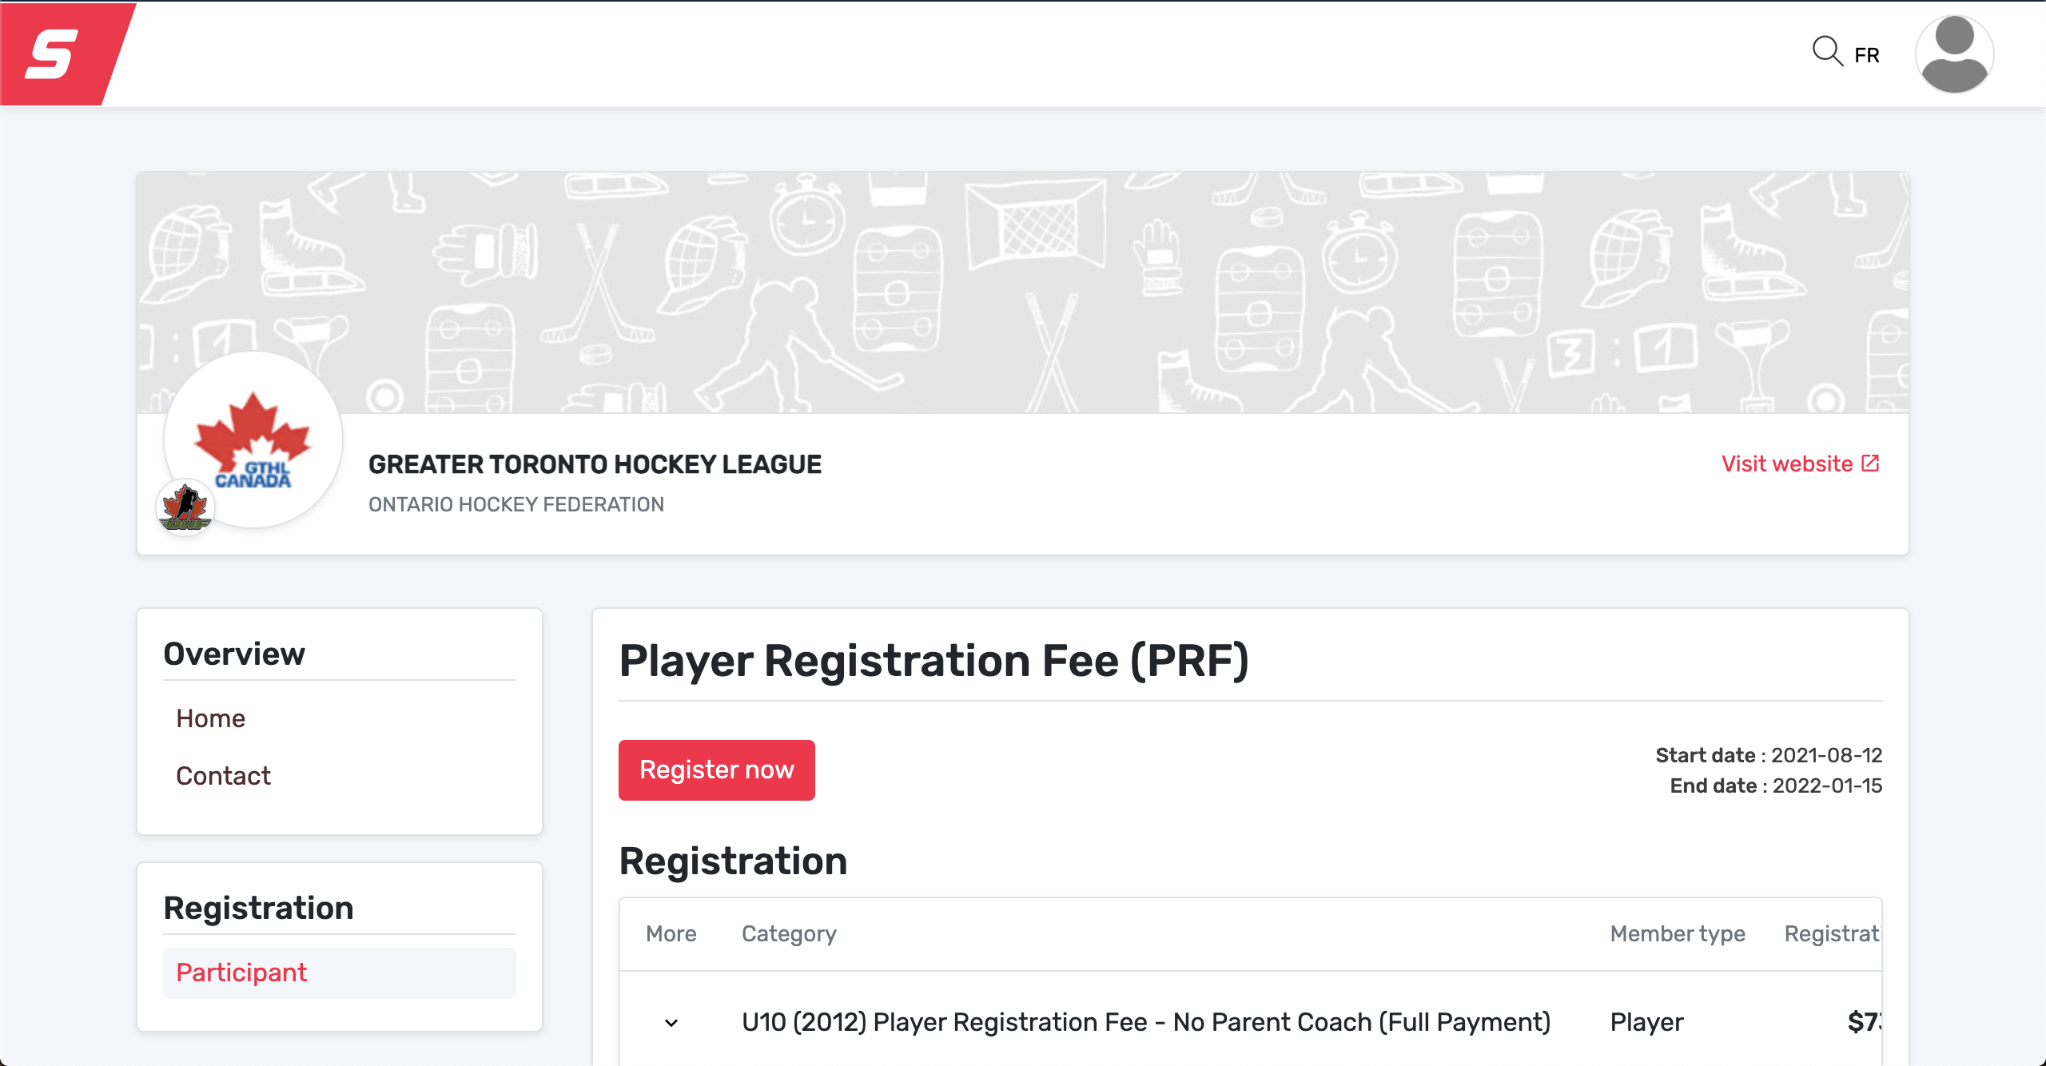
Payment Process
The registration link is available on the GTHL website under Players & Parents > Player Registration Fee. If you haven’t set up your new account in Hockey Canada, you must do that first at https://account.spordle.com/

Slide 14
Payment Process
Select existing participant to continue. If you haven’t registered your participant, select register a participant.

Slide 15
Payment Process
Choose to search your player by their HCR # or first and last name and date of birth and click search.

Slide 16
Payment Process
Once your player’s name is found, a box will pop up with the confirmed information, click select. If your player doesn’t show up, please make sure all information is correct.

Slide 17
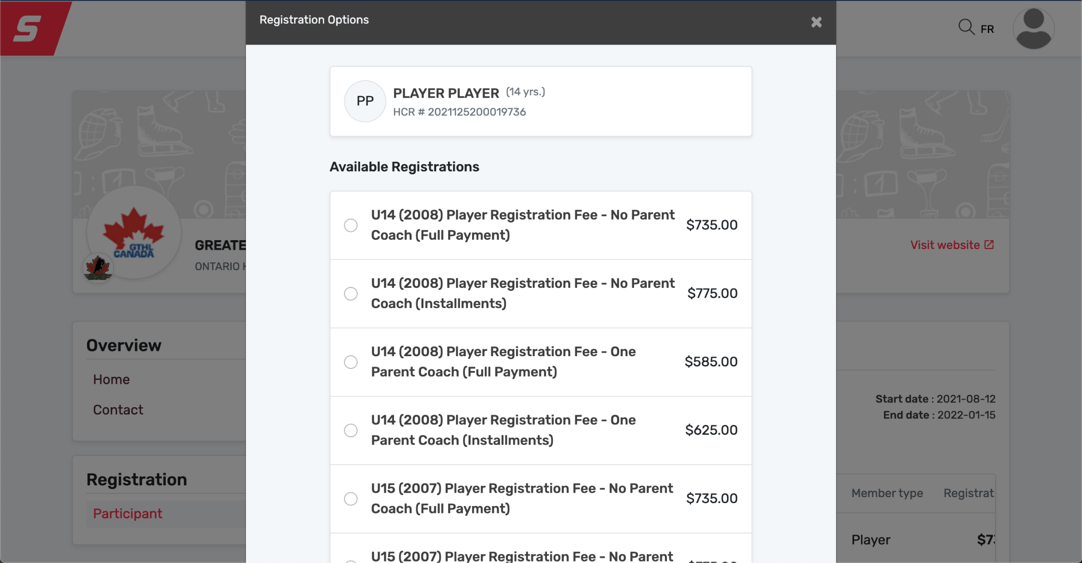
Payment Process
The player’s date of birth will populate the options by year of birth. Choose the plan that matches your YEAR of BIRTH, and select full payment or installments, according to your preference. Note; all discounted packages that are selected will be confirmed by our Office.

Slide 18
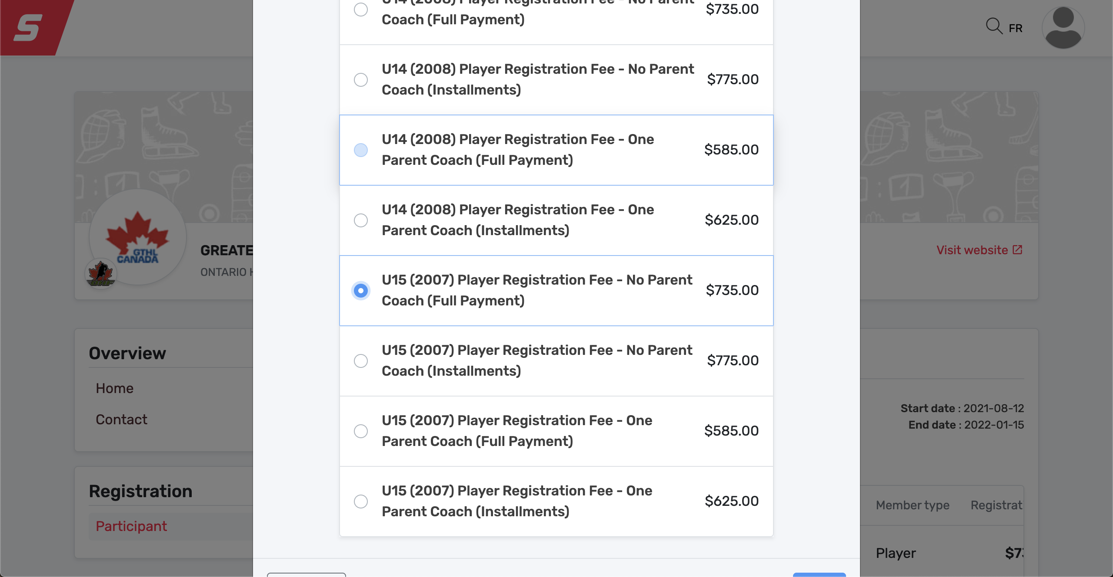
Payment Process
Once you choose your package, you will click the circle and click next.

Slide 19
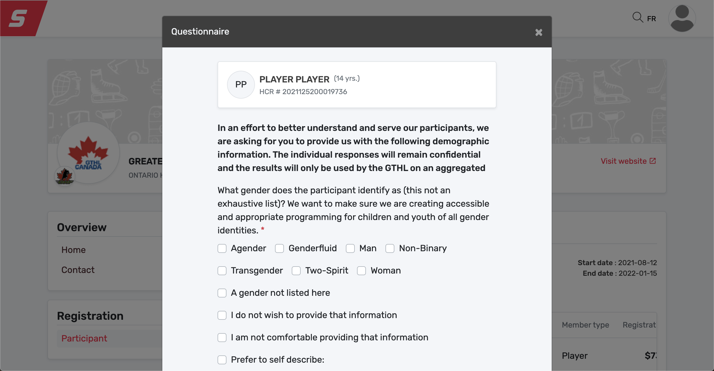
Payment Process
Completing the questionnaire will be required to move forward.
Please select all options that pertain to you. Click next.

Slide 20
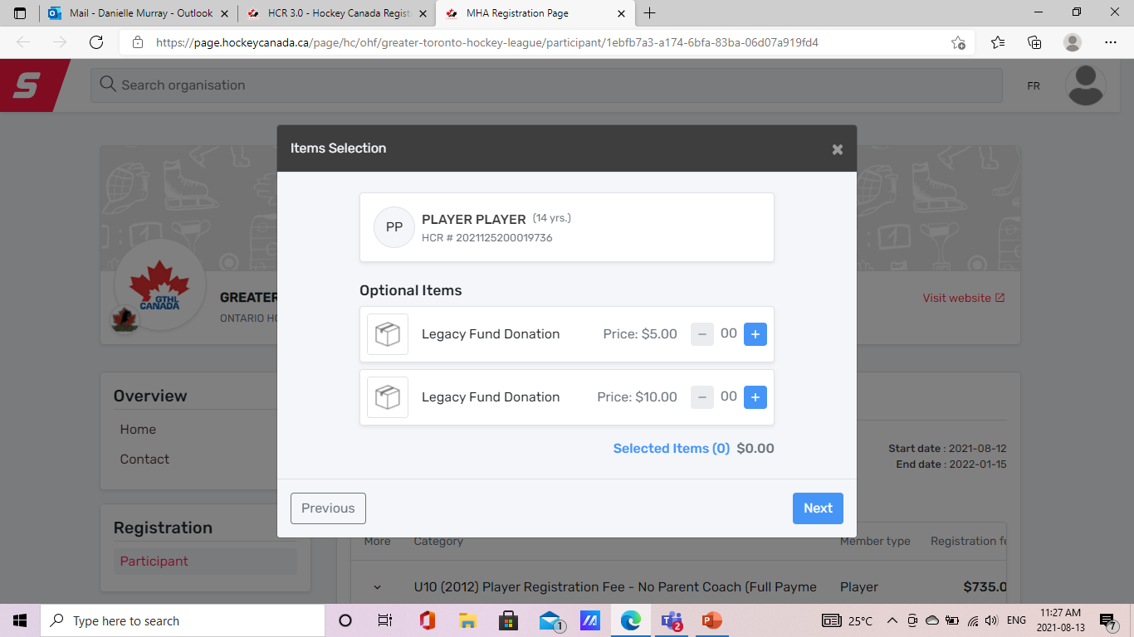
Payment Process
The Greater Toronto Hockey League (GTHL) launched the Legacy Fund as part of it’s 100th Anniversary Celebration in 2011. The Fund is used to assist individual players with the financial expenses involved in accessing hockey programs. The Fund also provides seed money to organizations that develop programs aimed at providing hockey opportunities to players and families who may not otherwise try the game of hockey.
To learn more visit Grants & Funding For Players – GTHL (gthlcanada.com)
This year with the GTHL Player Registration Fee you will have the option to donate $5, $10 to the GTHL Legacy Fund. If you would like to contributed a larger amount and receive a tax receipt you can make your donation directly through the Toronto Foundation GTHL Legacy Fund - Toronto Foundation
We thank you for any an all support you may be able to provide.

Slide 21
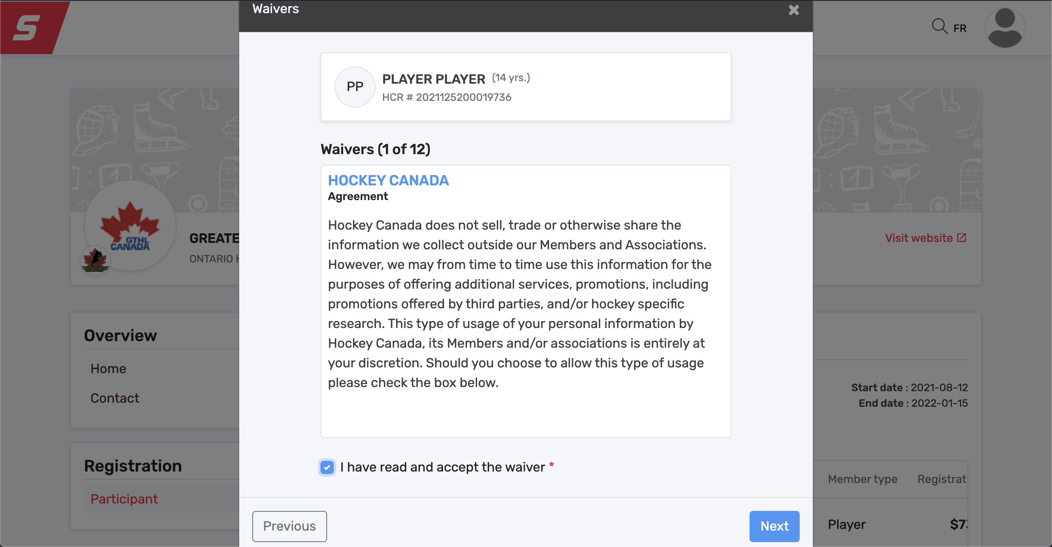
Payment Process
All Waivers will fall in order, you must sign off on each waiver to move forward. Click next.

Slide 22
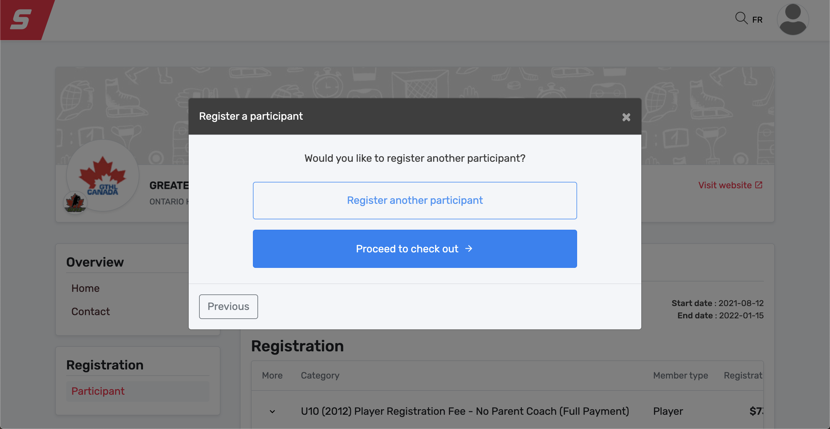
Payment Process
At this point, you will have the opportunity to Register another participant, or proceed to check out. If you have a second child who will participate on a GTHL A, AA, or AAA team, you can add them now to receive the sibling discount. Or, proceed to check out.

Slide 23
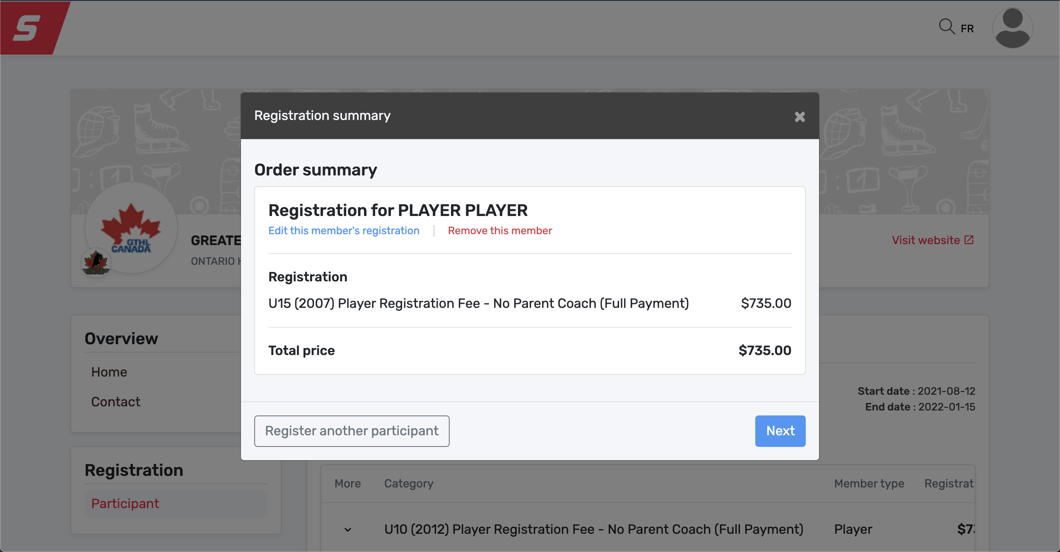
Payment Process
This page offers a summary of your registration. Please review and ensure everything is correct. You can also register a sibling at this point, by selecting register another participant, or select next.

Slide 24
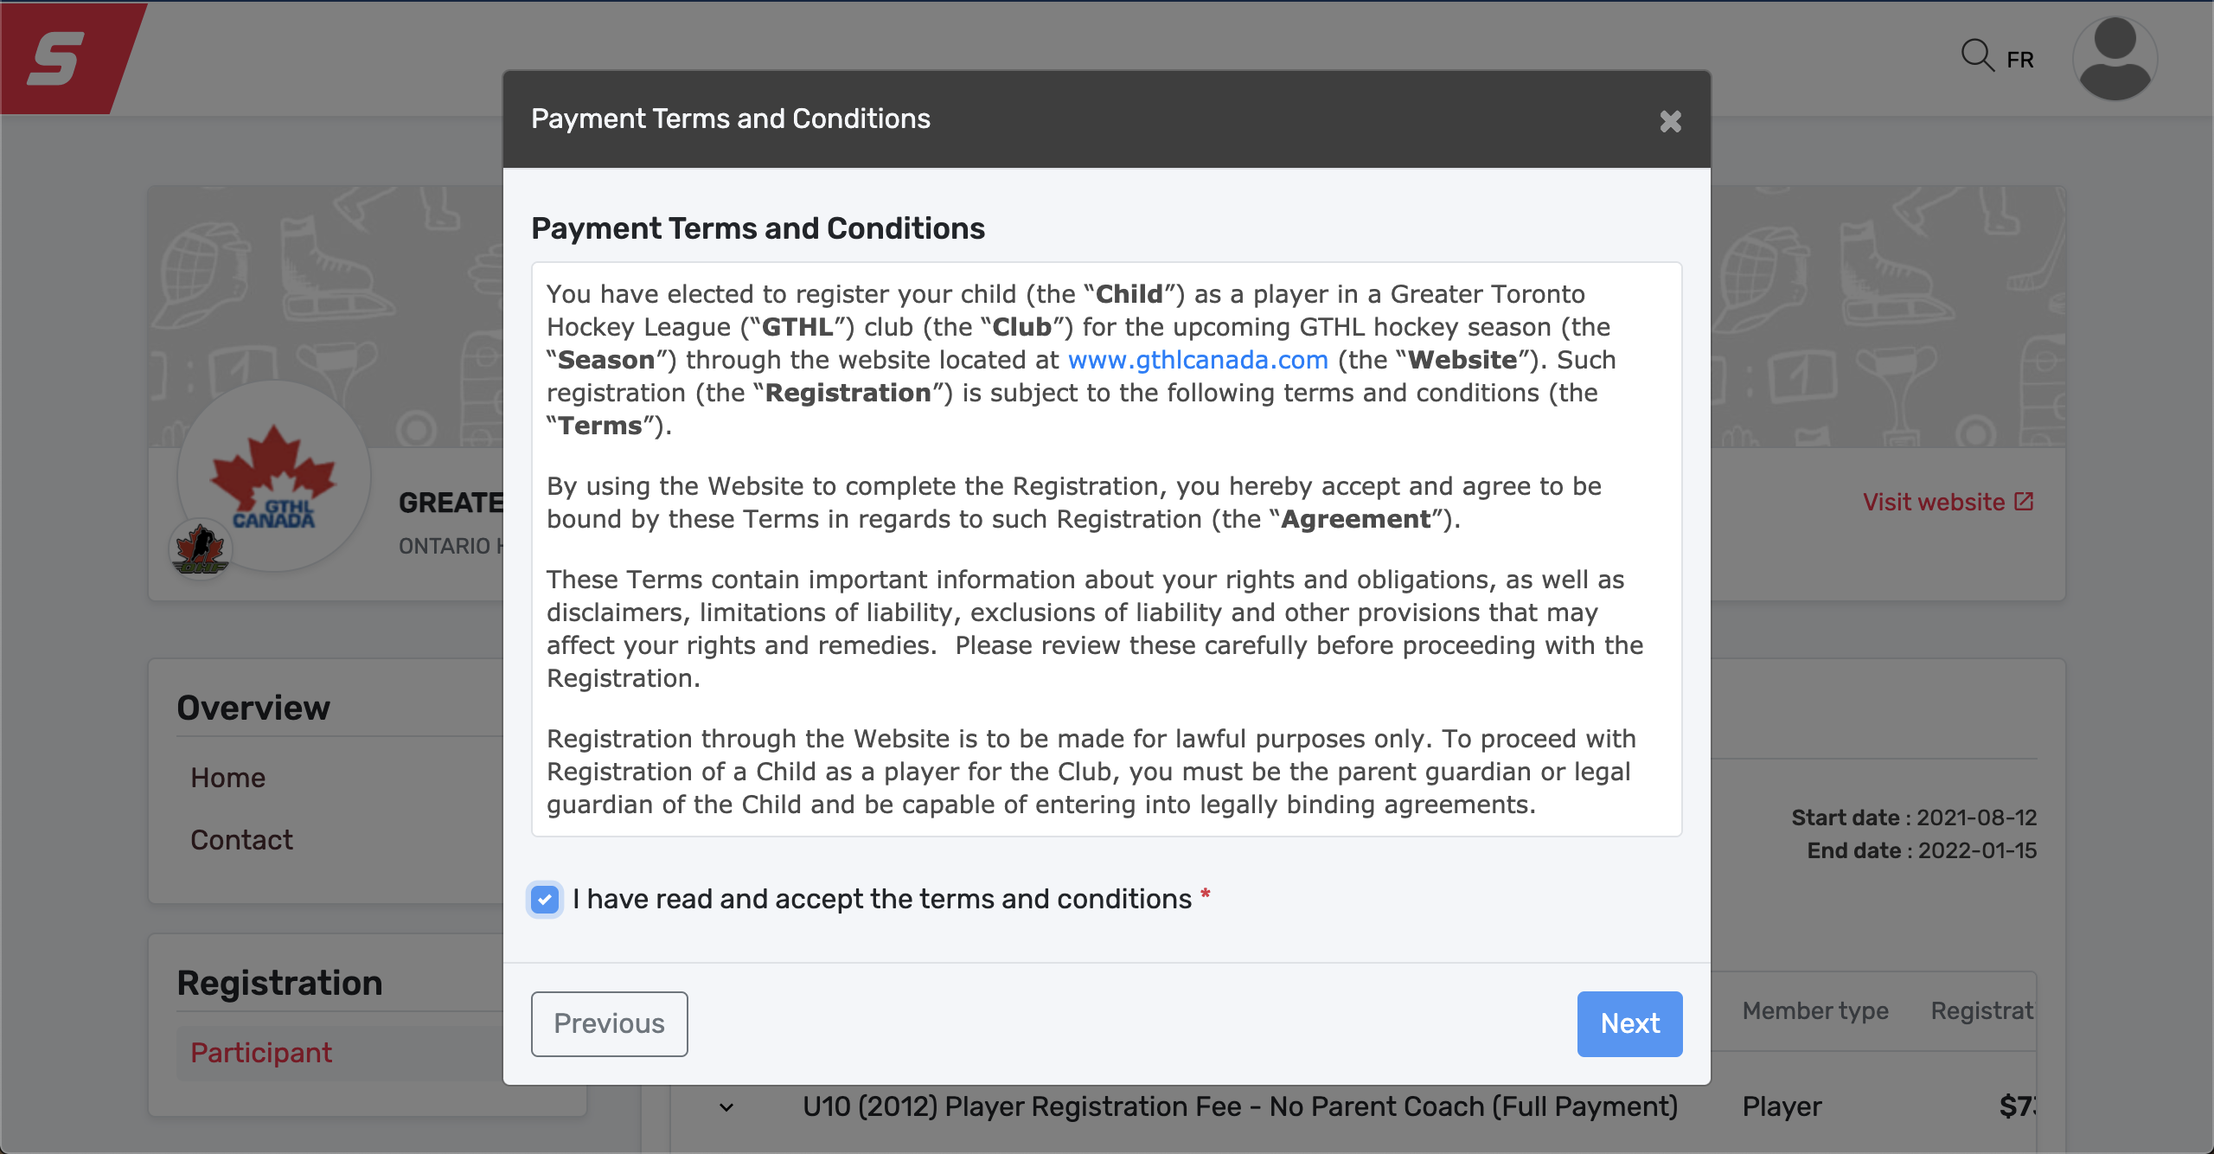
Payment Process
Please Review the Terms and Conditions, and sign off. Click NEXT

Slide 25
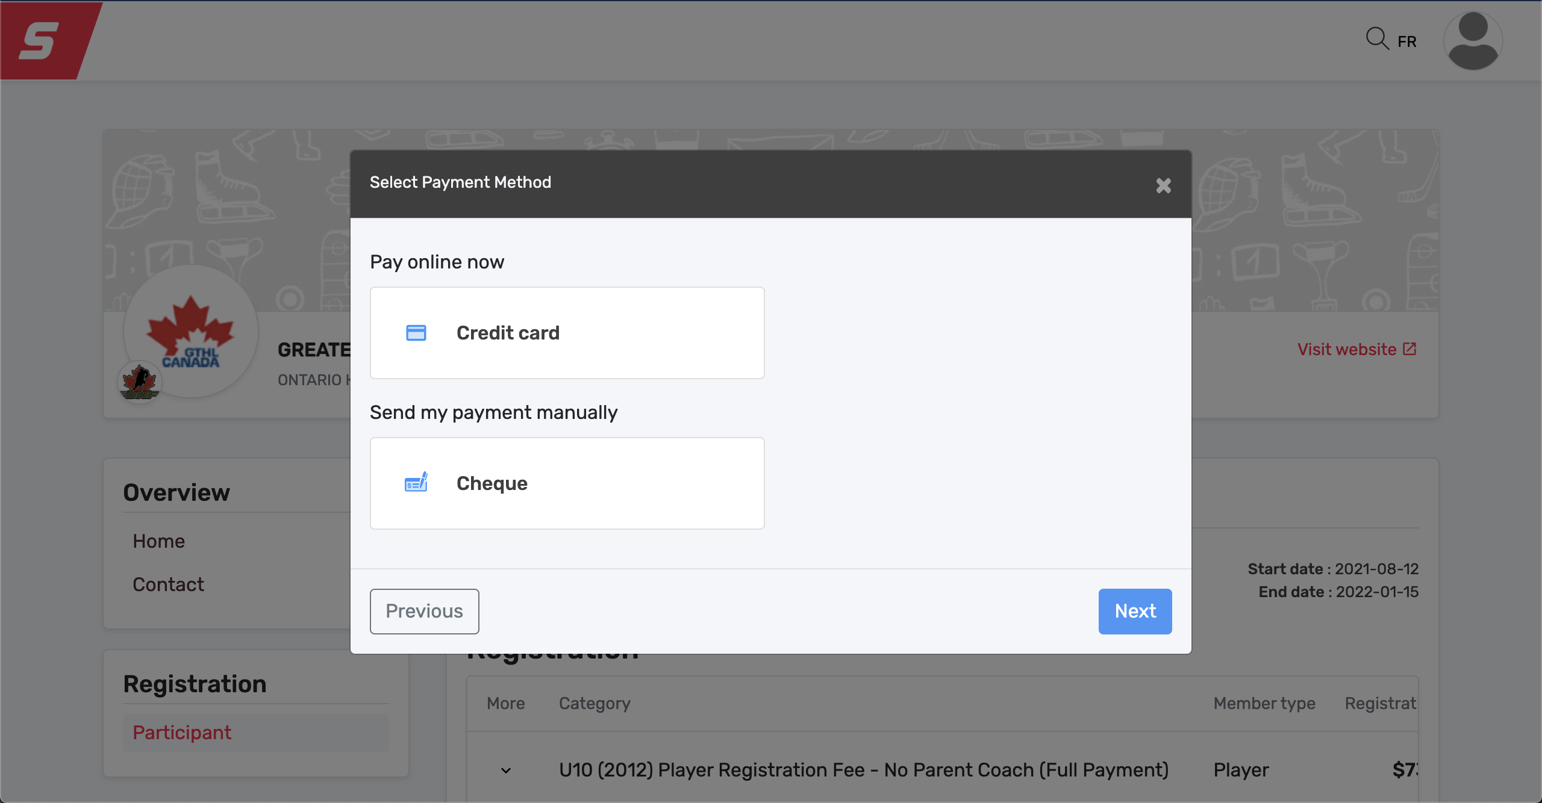
Payment Process
To pay online through credit card, select Credit Card. To pay through post dated Cheques, please select Cheque. Click Next. Cheques must be received immediately at the GTHL Office.
57 Carl Hall Rd, Toronto, ON M3K 2E2. In MEMO of cheques, please include Player Name and HCR #.

Slide 26
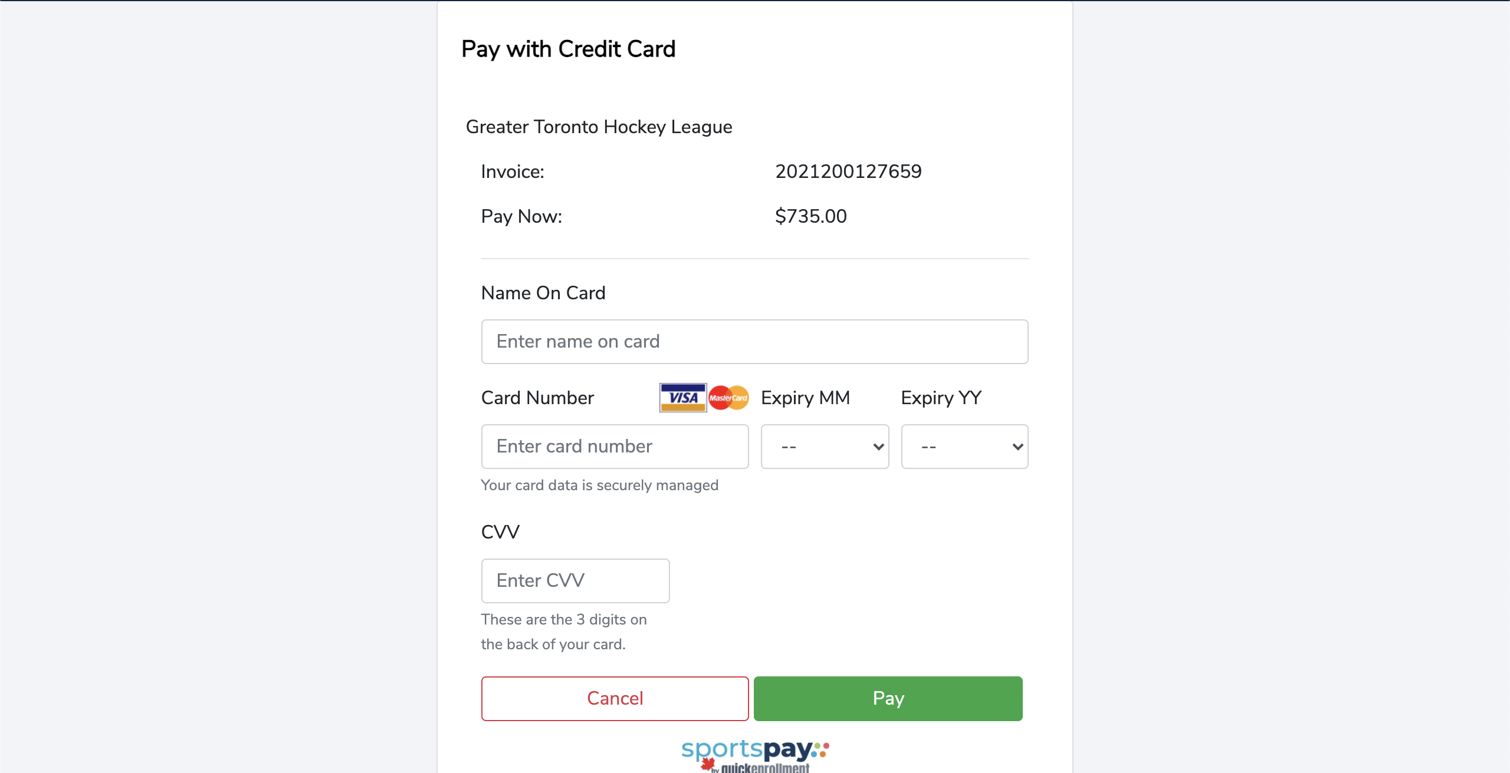
Payment Process
If Credit Card payment is selected, complete the payment page and click Pay.

Slide 27
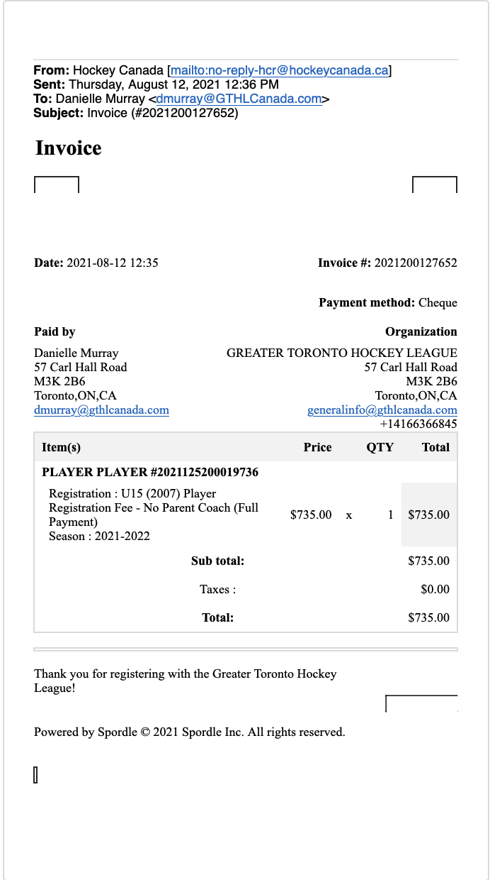
Payment Process
Whether you select Credit Card payment or Cheque, the system will generate and email an Invoice as shown below. Keep this for your records.

Slide 28
Section 4
Frequently Asked Questions (FAQ)

Slide 29
FAQs
1) How are the players on the games marked if they are ineligible?
Answer – They would not appear on the official roster on the electronic game sheet as their registration status would be ineligible. If they are ineligible from prior to season start they will not be registered nor approved to the roster until fees are resolved and they become eligible.
2) When a player registers late (for example, in December) is the player allowed to play immediately and/or is there a grace period to clear the payment process?
Answer – No, the player will be ineligible until the player registration fee (PRF) is paid and they are approved to a roster. Registrations after season-start are eligible for a pro-rated PRF. Please contact the GTHL office for this.
Will the Hockey Canada online registration system accept both Credit and Debit cards?
Answer – It will only accept Visa, Visa Debit and MasterCard. The League Office will accept post dated Cheques.

Slide 30
FAQs
Can I pay by cheque and how?
Answer – The online registration will allow you to “check-out” by cheque. The cheque(s) must be forwarded along with the order receipt to the GTHL office immediately. Cheques should contain; payable to Greater Toronto Hockey League, correct deposit dates, and order number/player name in memo section. Inquiries about cheque payments should be forwarded to dmurray@gthlcanada.com.
Cheques should be sent to or dropped off at the Greater Toronto Hockey League office:
Greater Toronto Hockey League
57 Carl Hall Rd.
Toronto, Ontario
M3K 2B6

Slide 31
FAQs
5) How is a player informed that playing privileges have been removed? Is the Club and Team informed as well?
Answer – The League office will notify the parent/guardian directly and also inform the respective Club of any changes to a player’s registration status.
6) How do we monitor the player’s games if playing privileges have been removed?
Answer – If a player participates while ineligible, League Rules governing participation of an ineligible player will be imposed. This provision is covered in GTHL Regulation 14.4: http://www.gthlcanada.com/page/rulebook#suspensions
7) Will families with applicable discounts have to pay the full amount up front?
Answer – No, discounts are applied at check-out upon submission of payment. If players are determined to have received a discount they are not eligible for, the player will become ineligible as per notice sent by the GTHL office until the full amount is paid.

Slide 32
FAQs
8) How are injuries defined for the purpose of determining if a player is entitled to a refund when injured?
Answer – A note from a Medical Doctor would be required. ONLY season-ending injuries or season-starting injuries will be eligible for refund.
9) If a payment date is missed, what are the consequences?
Answer – A player has 15 days after notification of an unsuccessful transaction to make a payment for the amount owing. After 15 days the full payment of the fee will be due and the player will be ineligible to participate until such time as payment is made. Furthermore, if the payment is not made within the 15 days, any discounts that were applied would become void.
10) Can a player receive more than one discount?
Answer – No, each player is only entitled to one discount – sibling or team official. Multiple players (siblings) can be on one order, but each player on the order is only entitled to a maximum of one discount.

Slide 33
FAQs
11) What happens if one parent coach is with one sibling’s team and the other parent is with the other sibling’s team?
Answer – Please call the GTHL office to have your discounts processed manually.
12) What happens if I select the wrong PRF package from my options?
Answer – Please call the GTHL office to have the correct package selected and make arrangements to pay the difference or have your discount applied.
13) What happens if the GTHL season is cancelled due to Public Health direction due to pandemic conditions related to Covid-19? Is there a refund?
Answer – In the event that the total number of regular season games from 28 (26 for U18 & U17 AA) and (24 for U21 A) as the result of a decision the local public health agency or a decision by the Federal, Provincial and/or Municipal government, each player affected by such decision will be refunded a portion of the Players Registration Fee on a pro-rated bases.

